Slide 1
DeployEgressLoadBalancer.json
Deploy Egress LB
Yes
DeployEgressFirewall.json
IgniteDeploy.json
DeployVm-Egress.json
Yes
DeployIPLoadBalancer.json
Deploy Egress LB
deployNsg.json
DeployIPFirewall.json
Yes
DeployVmIngress.json
vnet-existing.json
Existing VNET
vnet-new.json
No
DeployAppGw.json
Deploy Egress LB
Yes
DeployAppFirewall.json
deployVm-inbound-bs-no.json

Slide 2
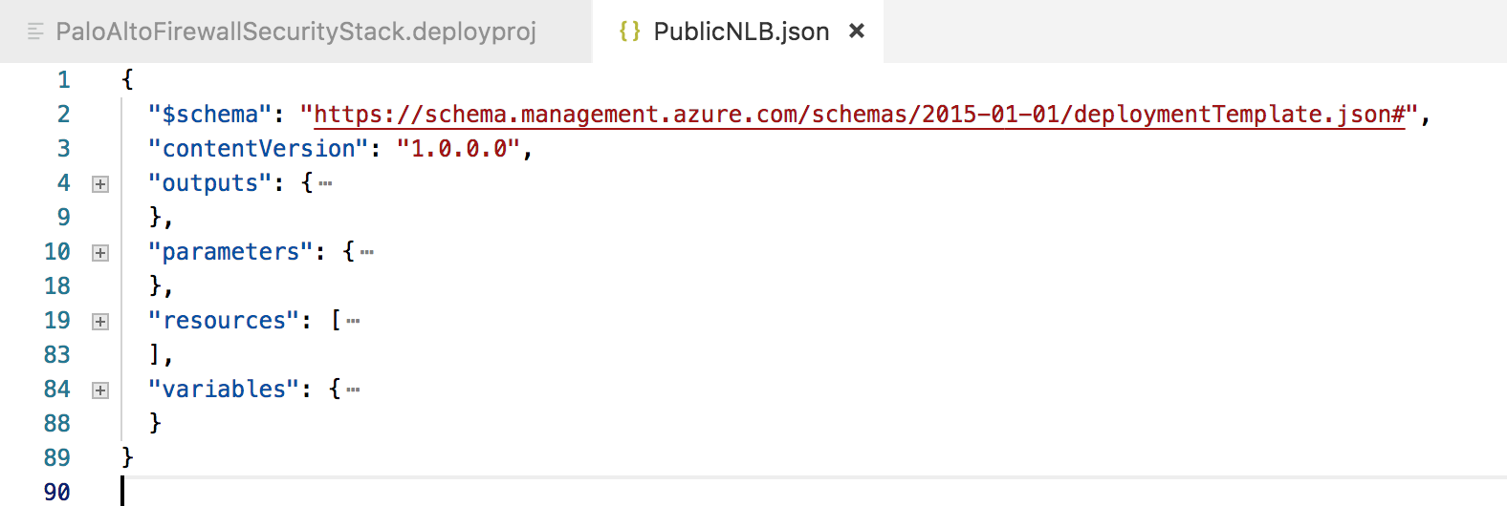
Working with Templates
Basic Structure of a Template
An Arm template always has the following
Parameters
Variables
Resources
Outputs

Slide 3
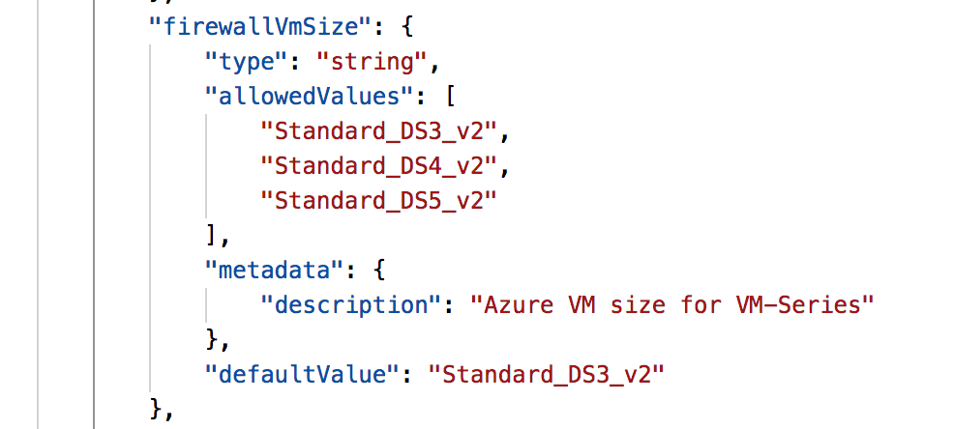
Parameters
Specify which values you can input when deploying the resources.
Provide the values that are tailored for a particular environment (such as dev, test, and production).
Without parameters your template would always deploy the same resources with the same names, locations, and properties.
"parameters": {
"<parameter-name>" : {
"type" : "<type-of-parameter-value>",
"defaultValue": "<default-value-of-parameter>",
"allowedValues": [ "<array-of-allowed-values>" ],
"minValue": <minimum-value-for-int>,
"maxValue": <maximum-value-for-int>,
"minLength": <minimum-length-for-string-or-array>,
"maxLength": <maximum-length-for-string-or-array-parameters>,
"metadata": {
"description": "<description-of-the parameter>"
}
}
}

Slide 4
Parameters – Best Practice
Minimize the number of parameters
When using linked templates, make the number of parameters the smallest set possible.
(More on linked templates later)
Don’t misuse the default value for parameters
Don’t set default values for required input parameters or parameters that need to differ over environments. If you want to pass a value, use a parameter file.

Slide 5
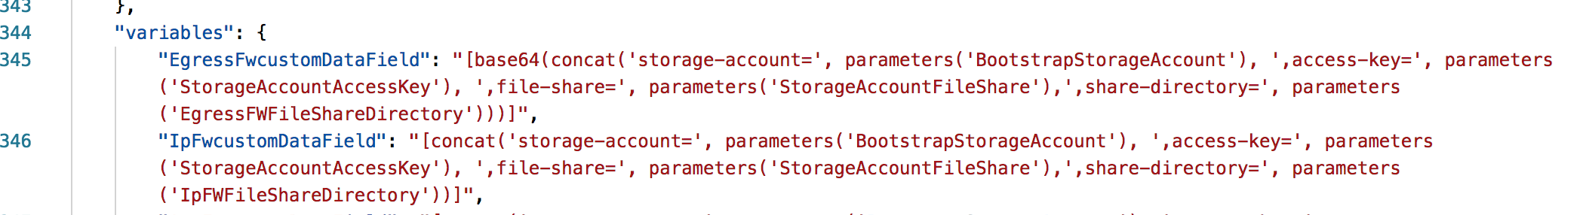
Variables
Guidelines
Use variables for values that you need to use more than once in a template.
If a value is used only once, a hard-coded value makes your template easier to read..
Include variables for resource names that must be unique..

Slide 6
Resources
VM Series Firewall Require the following Resources
VNET
Public IPs
Interfaces
Disk – Managed or Unmanaged
VM Instance

Slide 7
Resources
The order that instances are created in is important
The order they are defined in is NOT.
Use the “dependsOn” keyword to determine the creation order
This is the order in which we create the instances
Public IPs
Interfaces
Disk – Managed or Unmanaged
VM Instance

Slide 8
Resources – Public IP
{
{
"type": "Microsoft.Network/publicIPAddresses",
"name": "IP-FW1-Management",
"apiVersion": "2017-08-01",
"location": "[resourceGroup().location]",
"sku": {
"name": "Standard"
},
"properties": {
"publicIPAllocationMethod": "Static",
"idleTimeoutInMinutes": 4,
"dnsSettings": {
"domainNameLabel": "[concat('fw1management', variables('uniqueId'))]"
}
},
"resources": [],
"dependsOn": []
}, },
Optional SKU
Note:
"sku": { "name": "Standard"},
This is an optional parameter if the interface associated with the public IP is attached to a “Standard” Loadbalancer.

Slide 9
Resources - Interface
All firewalls must have IPForwarding
{
"apiVersion": "2015-06-15",
"type": "Microsoft.Network/networkInterfaces",
"name": "INT-FW1-Untrust",
"location": "[resourceGroup().location]",
"properties": {
"enableIPForwarding": true,
"ipConfigurations": [
{
"name": "FW1-Untrust",
"properties": {
"privateIPAllocationMethod": "Dynamic",
"publicIPAddress": {
"id": "[resourceId('Microsoft.Network/publicIPAddresses', 'IP-FW1-Untrust')]"
},
"primary": true,
"subnet": {
"id": "[concat(resourceId('Microsoft.Network/virtualNetworks', parameters('virtualNetworkName')), '/subnets/',parameters('untrustSubnetName'))]"
},
"loadBalancerBackendAddressPools": [
{
"id": "[concat(variables('lbId'), '/backendAddressPools/BackendPool')]"
}
]
}
}
]
}
},
Interfaces associated with loadbalancer by a backendpool definition

Slide 10
Resources – Virtual Machine
{
"apiVersion": "2016-04-30-preview",
"type": "Microsoft.Compute/virtualMachines",
"name": "VM-FW2",
"location": "[resourceGroup().location]",
"plan": {
"name": "[parameters('imageSku')]",
"product": "vmseries1",
"publisher": "paloaltonetworks"
},
"properties": {
"availabilitySet": {
"id": "[resourceId('Microsoft.Compute/availabilitySets', 'AS-FW')]"
},
"hardwareProfile": {
"vmSize": "[parameters('vmSize')]"
},
"osProfile": {
"computerName": "VM-FW2",
"adminUsername": "[parameters('Username')]",
"adminPassword": "[parameters('Password')]",
"customData": "[base64(variables('customDataField'))]"
BYOL/Bundle1/Bundle2
Instance Size
Optional Bootstrap Data

Slide 11
Resources – Virtual Machine (Continued)
BYOL/Bundle1/Bundle2
"storageProfile": {
"imageReference": {
"publisher": "paloaltonetworks",
"offer": "vmseries1",
"sku": "[parameters('imageSku')]",
"version": "[parameters('imageVersion')]"
},
"osDisk": {
"managedDisk": {
"storageAccountType": "Premium_LRS"
},
"caching": "ReadWrite",
"createOption": "FromImage"
}
},
"networkProfile": {
"networkInterfaces": [
{
"id": "[resourceId('Microsoft.Network/networkInterfaces', 'INT-FW2-Management')]",
"properties": {
"primary": true
}
},
Managed Disks
Optional Bootstrap Data

Slide 12
MS VDC Templates

